Slide 1
第二章 图像的数字化
童立靖
北方工业大学计算机学院
tong_lijing@163.com

Slide 2
第二章 图像的数字化
2.1 人眼的视觉特性
2.2 图像的数字化
2.3 数字图像的数值描述
2.4 数字图像的位图文件结构
2.5 数字图像的灰度直方图
2.6 非均匀量化与矢量量化

Slide 3

Key Points 要点：
Elements of Visual Perception
人眼视觉特性
Human vision
人眼视觉
Anormal vision
人眼非正常视觉
Vision illusion
人眼错觉
Vision in a higher level
更高层次的视觉
Video & Vision
视频与视觉特性

Slide 4
Human vision 人眼视觉
感光细胞(photoreceptor cells)：
杆状细胞(rod)：单色夜视
锥状细胞(cone)：彩色视觉
红(red)
绿(green)
蓝(blue)
Primary Color 基色

Slide 5
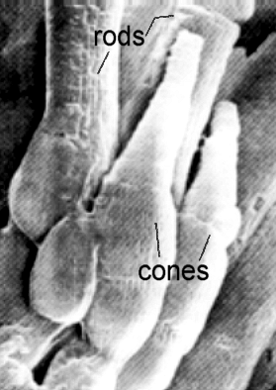
Electron Micrograph of Human Visual Receptors
Notes:
杆状细胞(rod)：单色夜视
锥状细胞(cone)：彩色视觉

Slide 6
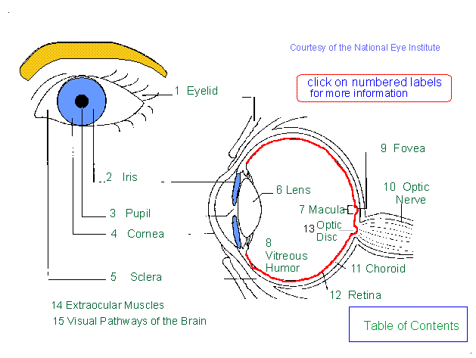

Slide 7
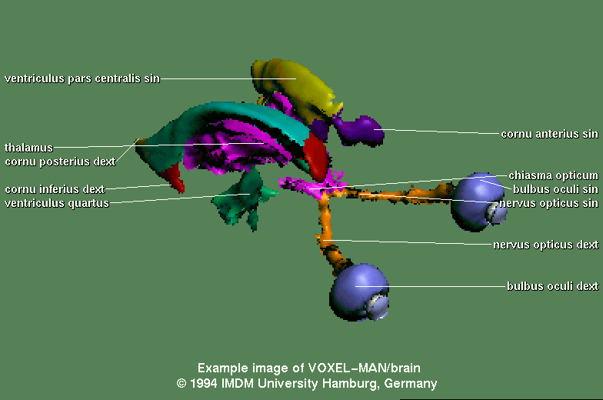

Slide 8
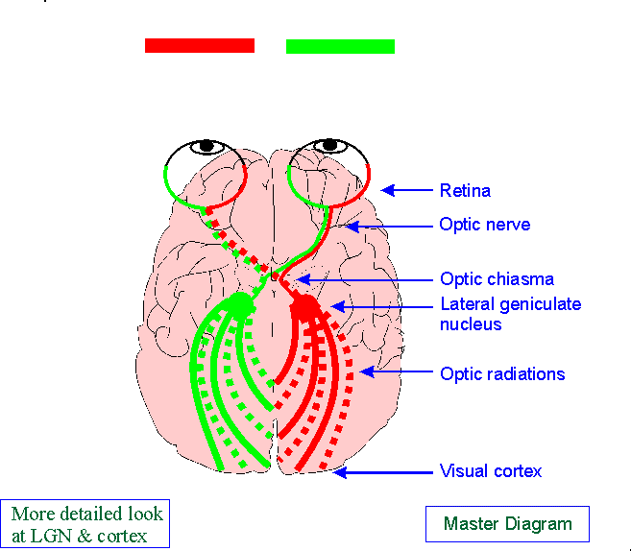

Slide 9
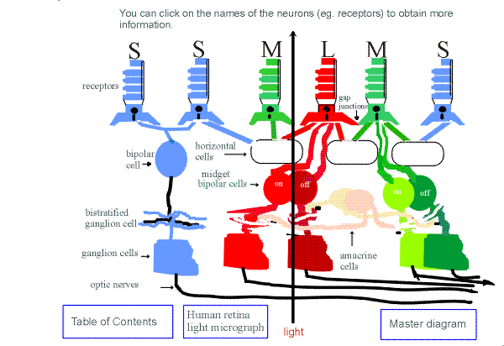
Retina
视网膜
Light enters the retina on the side containing the optic nerves and travels through all the layer before reaching the receptors.

Slide 10
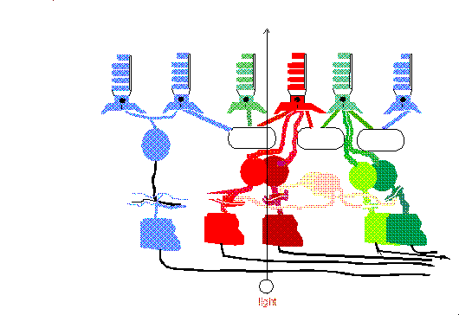
How light enters the retina and is transmitted out the optic nerve
This animated cartoon illustrates how light (white dot) enters the retina on the side containing the optic nerves and travels through all of the retinal layers before finally being absorbed by the photopigments in the outer segments of the receptors. A neural signal (yellow dot) is generated in the receptors which then travels through the neurons of the various retinal layers and finally travels out through the optic nerve up to the lateral geniculate nucleus.

Slide 11
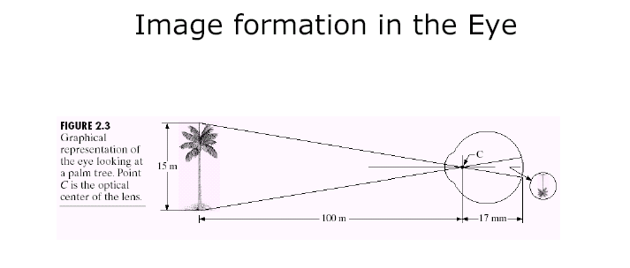

Slide 12
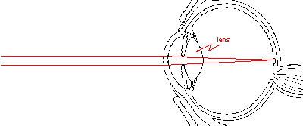
Refraction 折射
平行光入射

Slide 13
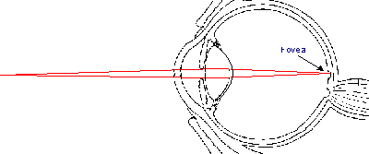
点光源入射

Slide 14
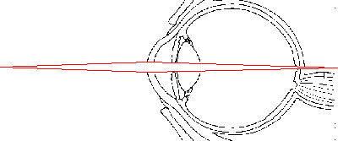
这是什么现象???
If the lens can not properly focus light on the retina, the image will fall either behind or in front of the retina.
Can you guess what would happen if the lens is too fat?

Slide 15
这是什么现象？老花。体会一下???
If the lens can not properly focus light on the retina, the image will fall either behind or in front of the retina.
Can you guess what would happen if the lens is too fat?

Slide 16
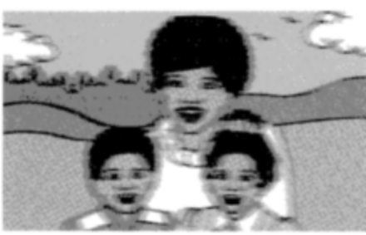

Slide 17
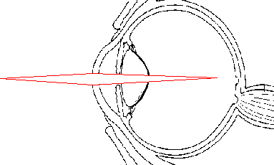
这是什么现象???怎么办???
If you guessed that when the lens is too fat that light is focussed in front of the retina, you were right.
Is there a remedy for lens problems that do not allow light to be properly focused on the retina? Sure.

Slide 18
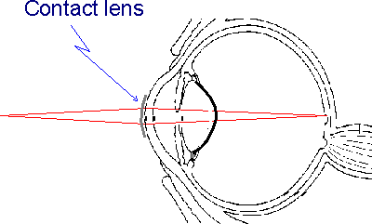
眼镜的作用。
Many people wear contact lenses to help image light properly on to the retina. Another solution is for a person to wear glasses. This places a lens in front of the eye not on the cornea as is the case with contact lenses.
A recent solution is to use a laser to reshape the cornea. this solution is possible only in some cases.

Slide 19
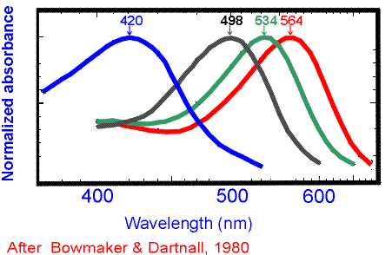
Spectral Sensitivity Curves of Rods & Cones
感光曲线（感光是一个范围）

Slide 20
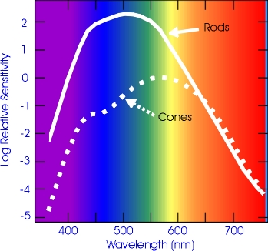
感光能力
有时灰度图像更有效：
军事照片
色弱飞行员

Slide 21
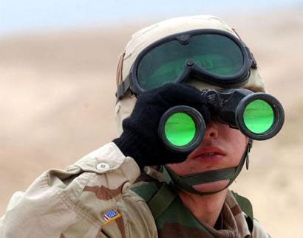
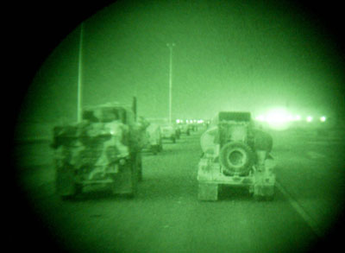
为什么是绿色???

Slide 22


Dark Adaptation
黑暗环境下的自适应
When you first enter an extremely bright environment, for example, when emerging from a dark movies house into a very bright sunlit area the man carving the duck would appear like this. But in less than a minute he will appear as seen below. In the left photo the contrast is very low. Below the contrast is normal.
When light adapted a scene might look like this.

Slide 23
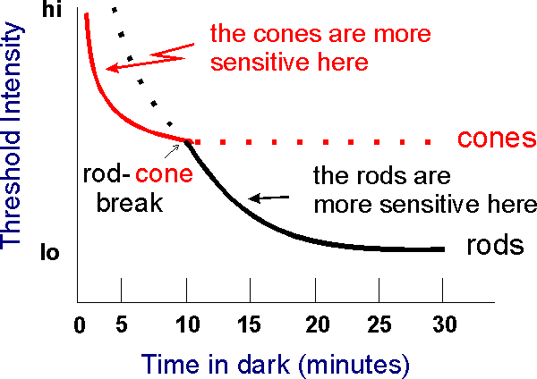
Dark Adaptation Function
强度阈值
时间
For approximately the first 10 minutes in the dark, the cones require less light to reach a threshold response than do the rods. Thereafter, the rods require less light.
The point at which the rods become more sensitive is called the rod-cone break.

Slide 24
Key Points 要点：
Elements of Visual Perception
人眼视觉特性
Human vision
人眼视觉
Anormal vision
人眼非正常视觉
Vision illusion
人眼错觉
Vision in a higher level
更高层次的视觉
Video & Vision
视频与视觉特性

Slide 25
Anormal Vision 非正常视觉
Color vision defects cause problems in the real world
The following demonstration is an example of how the world appears to a person with a severe type of color blindness, deuteranopia. See how you would do in a color blind world…

Slide 26
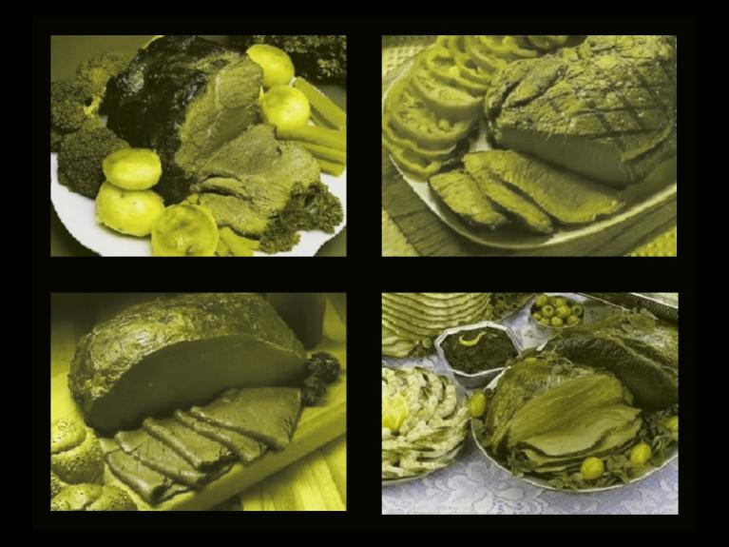
Which meat is the most
thoroughly cooked?

Slide 27
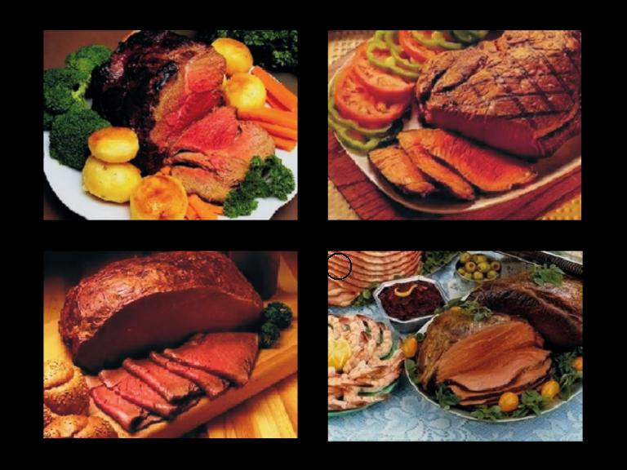
Which meat is the most
thoroughly cooked?

Slide 28
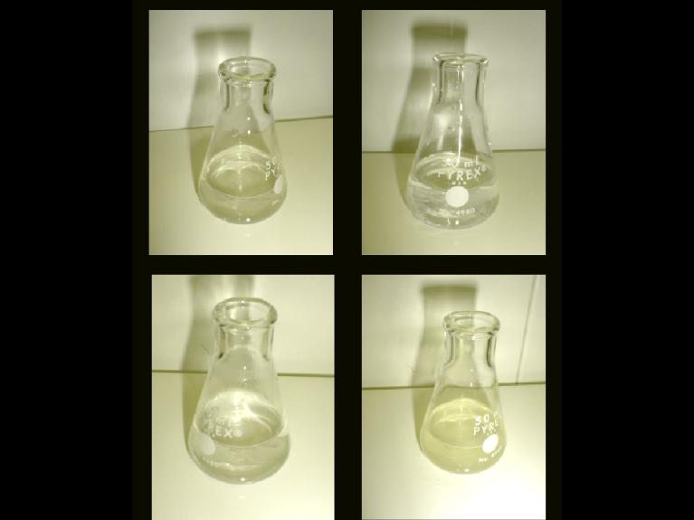
Which flask contains a light pink
solution?

Slide 29
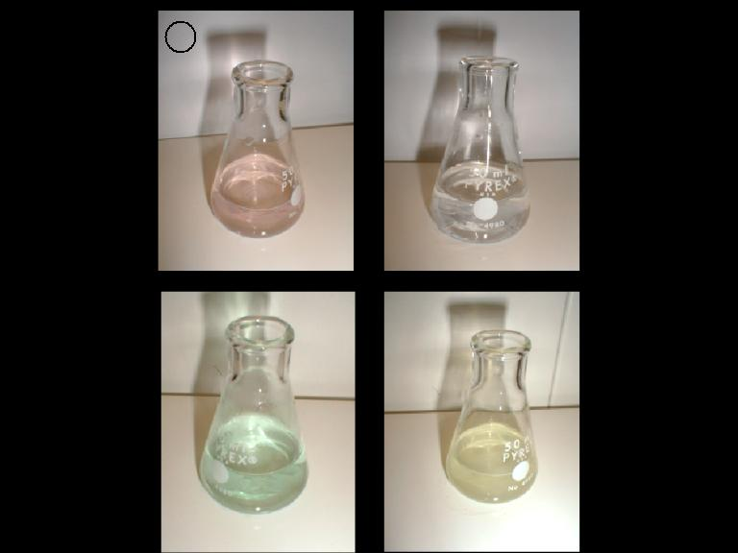
Which flask contains a light pink
solution?

Slide 30
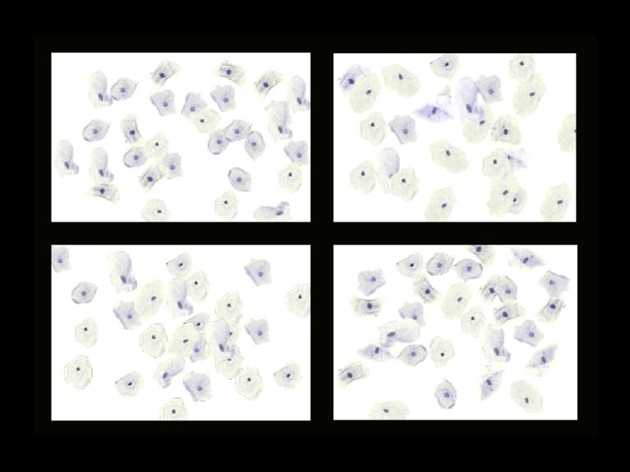
Which of the following slides
contains a pink cell?

Slide 31
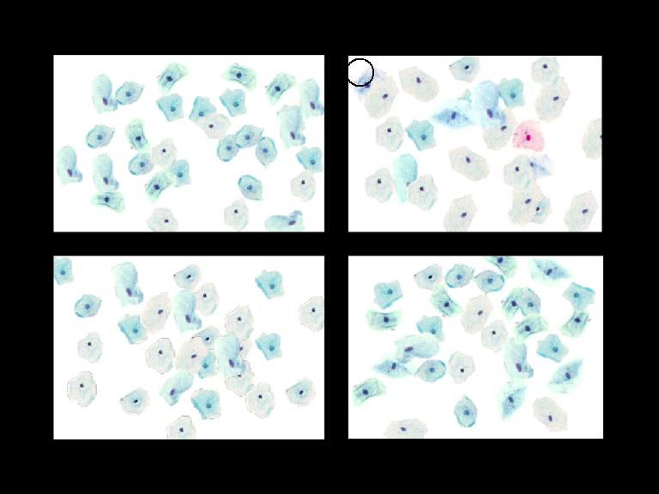
Which of the following slides
contains a pink cell?

Slide 32
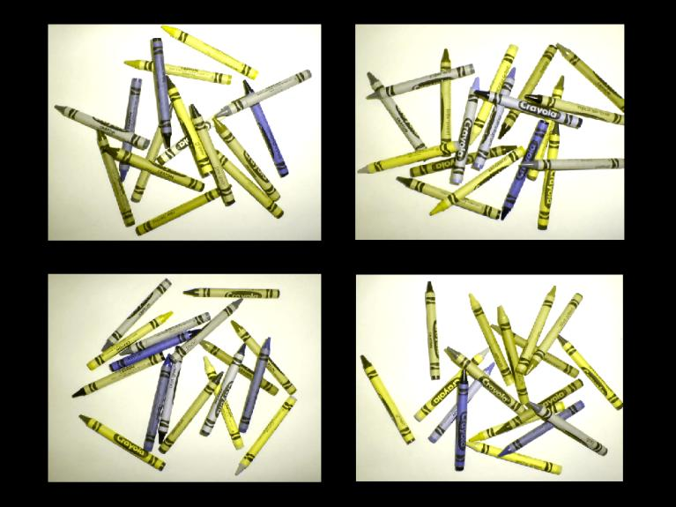
Which picture contains a red
crayon?

Slide 33
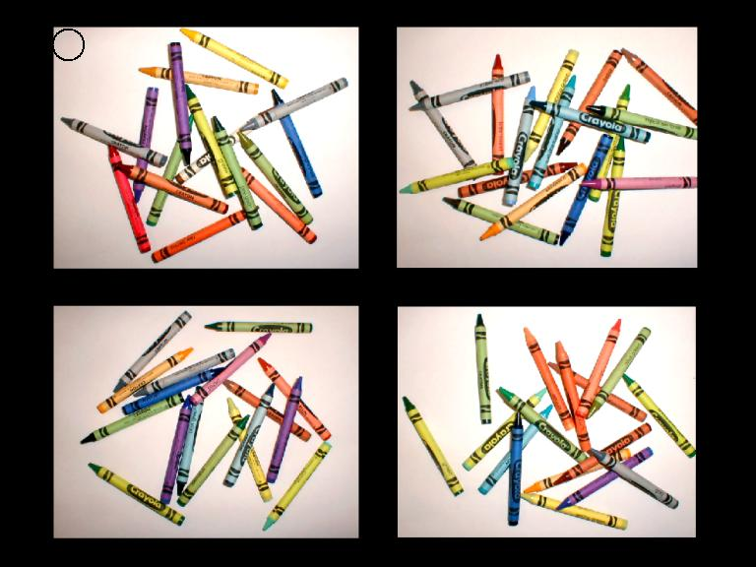
Which picture contains a red
crayon?

Slide 34

The use of color so that color blind people (and everyone else) can see what you are presenting.
正确的使用颜色。

Slide 35
正确的使用颜色
Red-green color blindness is common--about
4-5% of the population. In your presentations,
color should be used with care to ensure that
your color blind colleagues can see.
。

Slide 36
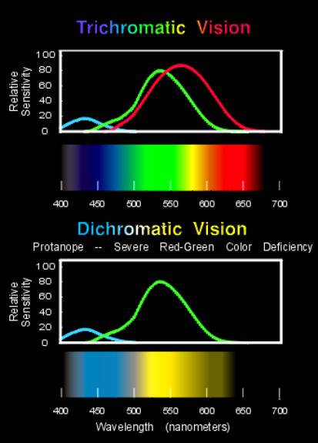
三色视觉与双色视觉的对比
In its most severe forms, color blindness is caused by the absence of one of the cone visual pigments. Shown here, the spectral sensitivities of the cone pigments in color normal trichromats are compared with those of a color blind person. Also compare the spectrum as it appears to a color normal person with the illustration of how it might look to a red-green color blind person.

Slide 37
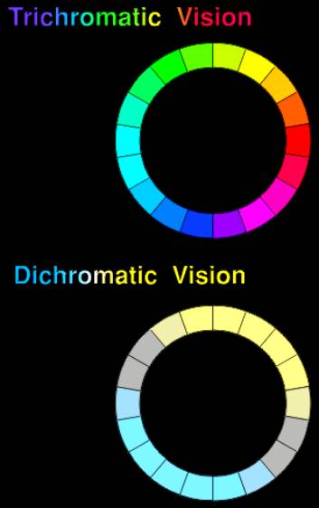
三色视觉与双色视觉的对比
The difficulties with certain colors can be illustrated on a color wheel. For a severely red-green color blind person there are only two hues, the ones a color normal person sees as yellow and blue. Intermediate colors, the ones seen as blueish- green and magenta, appear gray.

Slide 38
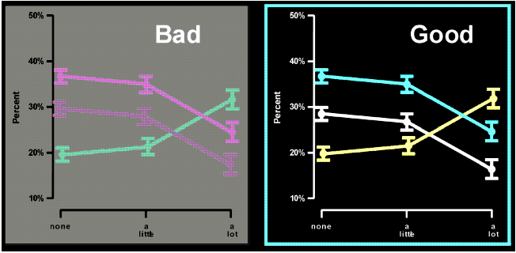
配色方案
Clear graphics are very important and often the source of the most difficulty; here are two examples showing the difference between good and bad use of color. The Trick is to keep brightness differences large and to avoid color combinations that do not contrast well.

Slide 39
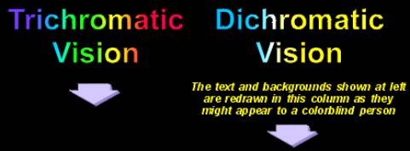
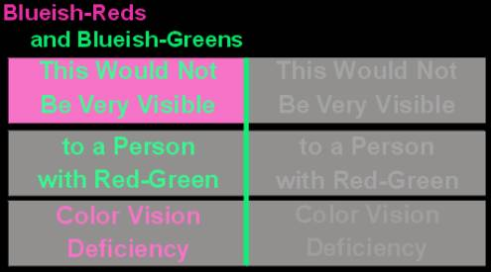
考虑双色视觉人群
A comparison of the two color wheels shows which color combinations would be difficult to see. Graphics cause the most problems, but the colors can be economically illustrated as text examples, below. The right-hand column illustrates how the left hand column might look to a color blind person.

Slide 40
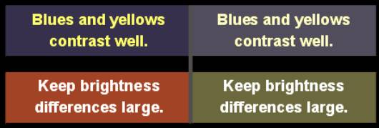
正确的方案
Some examples of color combinations that are easily seen by a color blind person are shown below. These are illustrated as text examples but these principles are most important to keep in mind when preparing drawings, graphs, and figures.

Slide 41
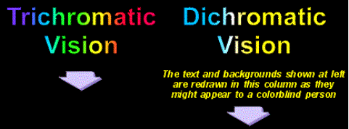
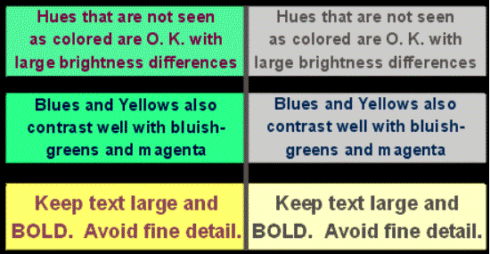
正确的方案

Slide 42
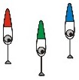
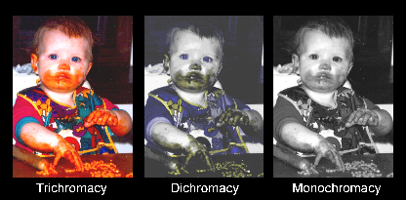
cone

Slide 43
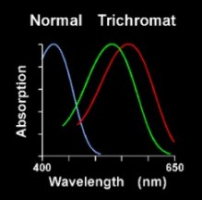
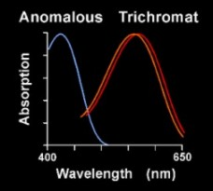
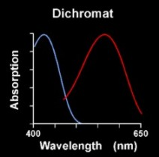
异常的三色视觉

Slide 44
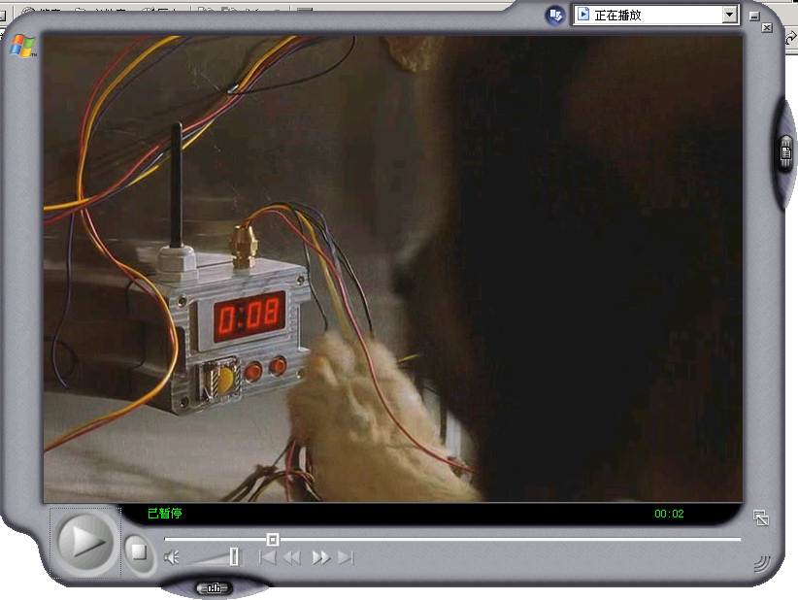
狗是色盲？
点击图片
播放视频

Slide 45
狗是色盲？
狗是只能看到黑白二色的色盲——这确实是一种误解。不过，如果这里所说的“色盲”是指狗儿只能看到人眼可见光谱中的一部分，那就对了。 科学家能用两套方法证明这一点，首先，弄明白狗儿如何“看”非常重要。狗儿的视网膜上有两种颜色感光器官，即视锥细胞，辨别短光波和中长光波，相对应于蓝色调（短光波）和红－黄色调（长光波）。与此不同的是，人类有三种视锥细胞，能看到组成可见光谱的所有颜色。由于狗儿只有两种视锥细胞，所以它们所能辨别的颜色与人类红绿色盲所看到的颜色一样。

Slide 46
Key Points 要点：
Elements of Visual Perception
人眼视觉特性
Human vision
人眼视觉
Anormal vision
人眼非正常视觉
Vision illusion
人眼错觉
Vision in a higher level
更高层次的视觉
Video & Vision
视频与视觉特性

Slide 47
Video of Professor
Notes:
41.30
40’55-51’16

Slide 48
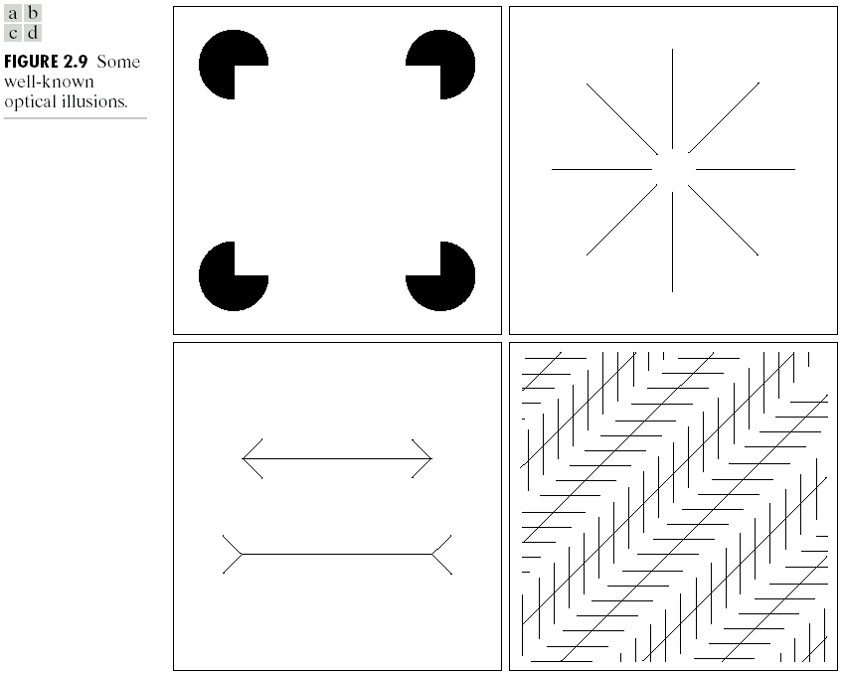
Vision illusion 眼见为实？

Slide 49
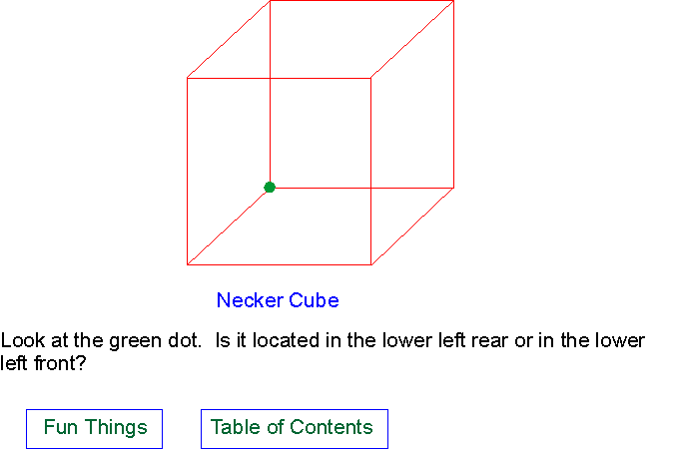
Necker Cube Illusion
前面还是后面？

Slide 50
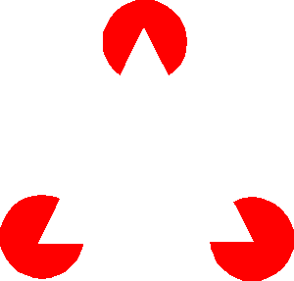
Kanizsa Illusion
This is called a Kanizsa figure after the person who invented it. If you look carefully you will probably see the edges of the entire triangle, even though the triangle is defined only by the notches in the red disks.

Slide 51
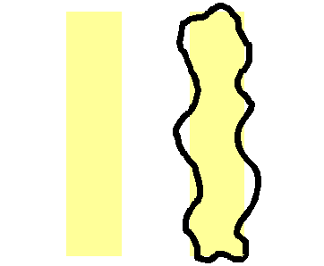
Boynton Illusion
Notes:
Examine these figures closely. Note the yellow areas on the left and on the right. Now step back from your computer screen about 6 or 8 feet and look at them again. Do they still appear as they did close up? Most people would probably see the shape of the right yellow area defined by the black squiggly line. It is generally assumed that luminance is mediated primarily by the long and middle wavelength cones. There is little luminance contrast between the yellow and white areas. This implies that the excitations of L and M cones are approximately equal and the isoluminant contrast is mediated by the short wavelength cone system.
The filling-in phenomenon confirms that the spatial resolution of the short wavelength cone system is poor. Also, it demonstrates that areas of color, mediated by the y-b opponent system tend to be constrained by contours mediated by the long and middle wavelength sensitive cones.
Boynton predicted this illusion before he produced it for the first time.

Slide 52
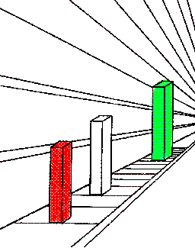
Perspective Illusion
Notes:
Which colored block appears the largest and which the smallest? Take a ruler and measure them, you may be surprised at what you find. I hope you measured the blocks. If you did you will have noticed that they are all the same size. Why then do they appear to increase in size as they get further away? Think about it. Maybe you can guess why.
Take close look at the pattern on the floor, walls and ceiling. Can you see how they tend to converge on to a common point in the distance? This is called perspective. The further way objects are the smaller the visual angle they subtend on the retina. However, if you were actually standing in the hallway containing the blocks the floor pattern and those on the walls and ceiling would not seem to converge. Another example is when you stand in the middle of rail road tracks (beware of trains) the parallel tracks continue to appear parallel for a long way into the distance even though they project onto your retina in perspective.
Artists are well aware of perspective and use it to create the impression of distance in their painting and drawings.

Slide 53
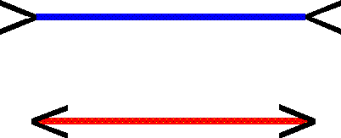
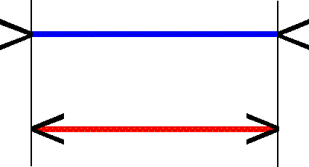
Mueller-Lyer Illusion
Which is longer, the red line or the blue line? Use a ruler to find out the answer. Select the answer to double check on your result.

Slide 54
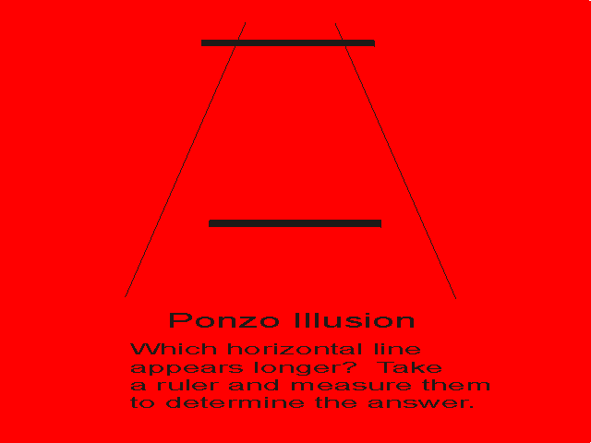

Slide 55
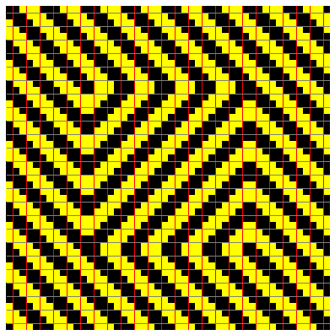

Slide 57
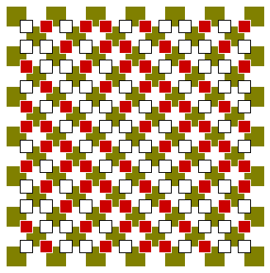

Slide 59

Mach Bands Effect 马赫带效应

Slide 60

Mach Bands Effect 马赫带效应
Notes:
The solid black curve represents the amount of light being reflected from the figure at the top. The red curve represents the brightnesses of this figure as it is usually perceived.
To the left of the point where the figure just starts to get lighter people usually see a dark bar that is slightly darker that the area to the left of it.
At the point where the brightness just stops increasing, people usually perceive a bright bar.
This phenomenon was discovered by the famous physicist, Ernst Mach and it is in his honor that these dark and bright bars are called Mach Bands. These Mach Bands can be explained by center-surround receptive field interactions which is discussed elsewhere in this book.
The receptive fields are represented as a disk (+) and annulus (-). The center disk is an excitatory area and the annulus an inhibitory area. The receptive fields in the uniformly white and uniformly black areas receive about the same stimulation in their excitatory centers and inhibitory surrounds. Therefore the center excitations are in balance with the surround inhibitions.
The receptive field over the bright Mach Band gives a stronger response in the center because part of the surround is in the darker area. Therefore it receives less inhibition from the surround than did the center at the extreme left and right ends. The receptive field over the dark band receives more surround inhibition because part of the surround is in the brighter area. Therefore, the excitatory response is less and this results in our seeing that the area as darker.

Slide 61

Simultaneous Contrast
哪个更亮
The round dots are all exactly the same color gray. I merely created the one on the extreme right and then copied it to each of the darker rectangles.
Clearly, the lightness of the background effects the way in which we perceive the center gray dot. This effect is called simultaneous contrast. Again, as can be seen in other demonstrations, the perception of this kind of display is a result of lateral interactions.

Slide 62

Simultaneous Contrast
哪个更亮
The circular area in each quadrant in the left figure is exactly the same color. The different appearance is due to the surround and the lateral interactions that occur. On the right I merely changed the background colors so that they are all identical. You can now see that the circular areas are, indeed, identical.
This phenomenon is called simultaneous color contrast.

Slide 63

Radiating Lines 辐射线
灰度变化?
Notes:
You undoubtedly saw a square figure which had a small rather light square area in the center and increasingly darker perimetric strips extending to the edge. You probably also saw bright arms radiating diagonally out from the center. This figure was adapted from a chromatic version designed by V. Vasarely (Arcturus (1970) as reported in Hurvich, 1981.
These brighter diagonal areas are physically not in the figure. That is to say, if you were to use a light measuring instrument (a photometer) and measure the amount of light coming from any of the concentric perimetric strips you would find that the same amount of light is reflected from all points along any one strip. Yes, that includes that part of the strip along the diagonal where it appears brighter. Consequently, that must mean that this brightness illusion is generated in the visual system. Just incase I have confused you, perhaps looking at a photometric plot of the illusion will help.

Slide 64

Color Influences Distance Perception
色彩对距离感知的影响
Notes:
Some people tend to see shorter wavelength colors (greens, blues, violets, etc) as further way than equally bright longer wavelength colors (yellows, oranges, reds). Brighter colors tend to be seen as closer.
Take another look at the red and blue Z's and see if you agree with these observations

Slide 65

Color Assimilation 色彩同化
Take two pieces of paper and place their edges as close as possible to both sides of one red diagonal. Note that the red square in the middle is the same as all the other squares on that diagonal. Now move your pieces of paper to expose mainly the red squares on the other diagonal. On this diagonal all the red squares, including the center one, are again the same color red. Because the center square is common to both diagonals this exercise proves that all the red squares in both diagonals are exactly the same red color. Yet, when the pattern is seen as a whole, the two red diagonals appear different from each other
Notes:
This demonstration is an example of the assimilation or "spreading" effect. The blue or yellow (depending on the diagonal) areas adjacent to the red squares influence the appearance of the red squares. The yellow make the red appear lighter and the blue make the red appear darker. This is because the blue is a considerably darker color than the yellow. You may also note that the yellow casts a slight yellowish tinge on the red squares and the blue a very slight bluish tinge. It is as if a blending of colors occurs. This phenomenon is the opposite of a contrast effect where one expects near by colors to accentuate the differences between adjacent areas.
Hurvich and Jameson believe that the physiological basis for the assimilation phenomenon is the spatial nonuniformity of the retina and its cellular organization. If the reader would like more information on their theorizing I recommend taking a look at pages 175-177 in COLOR VISION by Leo M. Hurvich (Sinauer Assoc. Inc. Publisher) 1981.

Slide 66

Hermann Grid Illusion
Hermann网格幻觉
请快速转动眼睛看看
Notes:
Look closely at this matrix of black squares. What do you see? While scanning over the matrix do you see something peculiar in the intersections of the white crosses formed by the black squares? If you see dark blobs, don't be surprised, that is what most people see.
This figure is called the Hermann grid and the dark blobs can be explained by reference to receptive fields and lateral inhibition.
Just in case you think you are being fooled, try taking two pieces of paper and cover all but two vertical or horizontal rows of black squares. Do you still see the dark blobs when viewing only part of the Hermann grid?
There is a reasonable explanation for this phenomenon. If you haven't yet looked at the receptive field story you should look at it or else the explanation for the Hermann grid won't make a lot of sense to you.
To understand the receptive field explanation for the Hermann grid illusion requires a basic understanding of receptive fields.
Once again, it is a matter of lateral inhibition between the center and surround of the receptive field. Note the lower right part of the diagram. The receptive field that lies at the intersection of the white cross has more light falling on its inhibitory surround than does the receptive field that lies between the two black squares. Consequently, the excitatory center of this receptive field between the squares yields a stronger response than that which lies at the intersection of the white cross. This explanation is appropriate for those circumstances where the receptive fields are larger than the spaces between the squares.
Receptive fields in the central fovea are much smaller than in the rest of the retina. This is represented in the upper right of the diagram. In the Hermann grid you probably did not see a dark area when you looked directly at the intersection of the white cross, but did see dark areas in your peripheral vision. To prove to yourself that this is not some trick, just get up and walk away from your computer screen. When you are at some distance from it, you will undoubtedly notice that the dark blob is visible even at your fixation point. I leave it to you to figure out why this happens.

Slide 67

"Stabilization" Causes Fading
Look at the upper right figure. This experiment works better if you close one eye. Fixate on the black dot in the center for about 10 - 15 seconds. Pay close attention to what you see. Now do the same thing with the upper left figure.
Did you notice any difference? In the accompanying explanation I tell you what most people see and the reason for it.
Notes:
Our sensory systems do not seem to like steady state stimulation. For example, try this sometime. Fill a bath tub with water and lie in it. At first you feel the water over your whole body. Then after a minute or so you only feel the water at the edge where the air and water meet, i.e. the waterline. In a sense the visual system also does not like steady state stimulation. There is sophisticated apparatus that allows you to view a stimulus in such a way to nullify your natural eye movements so that the image of the stimulus remains on exactly the same part of the retina as if there were no eye movements. Such apparatus is called a stabilized image system.
You can simulate this effect with an after image. If you stare at a strong stimulus for about a minute and then look away you will continue to see an after image of the stimulus for some seconds and then it will disappear. But for a time you can bring it back to life by blinking. The blinking brings a temporal factor to the otherwise stabilized retinal image and it becomes visible for a while.
Now to the disappearing disk. Most people would see the smudge in the upper left disappear as they stared at the black dot. Most people would not see the smudge disappear in the upper right.
In the upper left, the darker area slowly becomes lighter as one moves away from the black dot. This gradual change from black to white is a poor stimulus for sustaining visual perception. However, if you allow your eyes to freely move over the stimulus the perception of it will be sustained. When you fixate on the black dot and try and hold your gaze as steady as possible the smudge should fade away and the color of the background would predominate.
The upper right figure is exactly the same as the upper left except for the dark gray ring. This dark gray ring is sufficient to keep the stimulus "alive" no matter how hard you stare.
When you fixate the black dot and try to hold your gaze as steady as possible, your eyes are still in constant motion. True, many of these eye movements are very tiny tremors as opposed to the large saccades or pursuit eye movements we make. Nevertheless these small tremors can keep a stimulus "alive". When the stimulus is one as in the upper left where there is a very gradual change from gray to white, the change in stimulation is so slight as to approach that encountered by the steady state condition of a stabilized image. As a result the image fades.
You will undoubtedly have noticed that even when you fixated the upper left field and the smudge disappeared, it would spontaneously reappear and then again fade. It reappeared because you made a large enough eye movement.
The dark gray ring in the lower left will respond to even the very small eye tremors thus keeping the image "alive."

Slide 68

Hering & Pogendorf Illusions

Slide 69

点击图片 播放FLASH

Slide 70

Horizontal-Vertical Illusion
点击图片 播放FLASH

Slide 71

Horizontal-Vertical Illusion
Which line is longer, the red one or the green one? Use a ruler to find out. You will probably be surprised.

Slide 72

Pogendorf Illusions
点击图片 播放FLASH

Slide 73

点击图片 播放FLASH

Slide 74

点击图片 播放FLASH

Slide 75


Slide 76

What do you see in this diagram? In order to find out what people often say they see select possible perceptions.
Notes:
Some people see the outline of two black faces opposite each other. Other people see a white vase. Sometimes people see the faces and vase alternating and yet other people can see both the faces and the vase simultaneously

Slide 77


Slide 78


Slide 79


Slide 80


Slide 81


Slide 82


Slide 83


Slide 84


Slide 85


Slide 86


Slide 87


Slide 89

点击图片
播放视频

Slide 90


Slide 91


Slide 92

Notes:
下巴还是鼻子？

Slide 93
Notes:
下巴还是鼻子？

Slide 94
Notes:
下巴还是鼻子？

Slide 95

点击图片 播放FLASH

Slide 96


Slide 97


Slide 98


Slide 99


Slide 100

屋顶内还是屋顶外？
顶面还是底面？
Notes:
屋顶上内，屋顶外，顶面还是底面？
视点在上角还是下角？

Slide 101


Slide 102


Slide 103


Slide 104


Slide 105


Slide 106
Key Points 要点：
Elements of Visual Perception
人眼视觉特性
Human vision
人眼视觉
Anormal vision
人眼非正常视觉
Vision illusion
人眼错觉
Vision in a higher level
更高层次的视觉
Video & Vision
视频与视觉特性

Slide 107
Vision in a Higher Level
更高层次的视觉
Perception 认知
Psychology 心理
Culture 文化

Slide 108

The actors in Oriental Song and Dance Ensemble performing the Spanish castanets dance "Fire of Love"
东方歌舞团的演员在演出西班牙响板舞《火之恋》
Warm –cool- McDonald 暖色 冷色 麦当劳

Slide 109

Vertigo Art 眩晕的艺术
一名参观者在澳大利亚悉尼当代艺术博物馆欣赏瑞士艺术家乌戈·龙迪诺内创作的一幅作品。龙迪诺内善于利用绘画、视频、雕刻和摄影创造情感和心理环境，并因此而闻名于世。照片中的作品使观赏者无法将视线集中在彩色的圆圈上，许多人感到眩晕，有人甚至感到头昏眼花。

Slide 110
红 白 黑
黄 绿

Slide 111
Key Points 要点：
Elements of Visual Perception
人眼视觉特性
Human vision
人眼视觉
Anormal vision
人眼非正常视觉
Vision illusion
人眼错觉
Vision in a higher level
更高层次的视觉
Video & Vision
视频与视觉特性

Slide 112

电影&视觉特性 Video&Vision
点击图片
播放视频
Movies take advantage of the visual characteristics of the human eyes.

Slide 113


Persistence of vision
视觉暂留

Slide 114
转动的窗户
TRP_WIN.MPA
Notes:
视觉暂留，loop

Slide 115

照片视频
点击图片
播放视频

Slide 116

快拍慢放or慢拍快放？
点击图片
播放视频
Notes:
快拍

Slide 117

快拍慢放or慢拍快放？
点击图片
播放视频
Notes:
快拍

Slide 118

快拍慢放or慢拍快放？
点击图片
播放视频
Notes:
慢拍
卓别林花絮.rm

Slide 119

快拍慢放or慢拍快放？
点击图片
播放视频
Notes:
慢拍

Slide 120
电 影 特 技
正排慢放
增强现实
自由视点视频

Slide 121
Terms
Photoreceptor cells:感光细胞
Rod: 杆状细胞
Cone: 锥状细胞
Retina: 视网膜
Iris: 虹膜
Fovea: 中央凹
Visual cortex: 视觉皮层

Slide 122
Key Points 要点：
Elements of Visual Perception
人眼视觉特性
Human vision
人眼视觉
Anormal vision
人眼非正常视觉
Vision illusion
人眼错觉
Vision in a higher level
更高层次的视觉
Video & Vision
视频与视觉特性

Slide 123
第二章 图像的数字化
2.1 人眼的视觉特性
2.2 图像的数字化
2.3 数字图像的数值描述
2.4 数字图像的位图文件结构
2.5 数字图像的灰度直方图
2.6 非均匀量化与矢量量化

Slide 124
第二章 图像的数字化
童立靖
北方工业大学计算机学院
tong_lijing@163.com

